Slide 1
Litigation Support, Investigations and
Expert Witness Services
Rick Potocek, CPA, MBA, CFE

Slide 2
Rick Potocek, CPA, MBA, CFE Forensic and Dispute Services Principal
More than 30 years of experience in fraud investigation
24 years as a special agent with the FBI
3½ years as a director of the forensic and dispute services practice of Deloitte financial advisory services
3 years in private practice

Slide 3
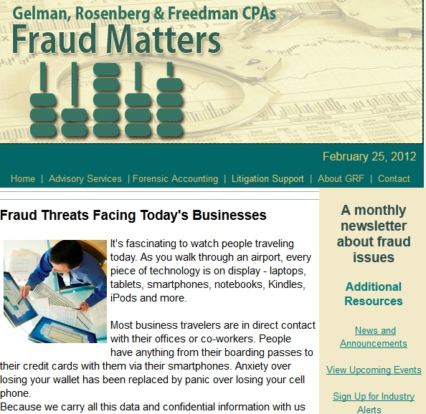
Subscribe to Gelman, Rosenberg & Freedman’s monthly newsletter about fraud issues.

Slide 4
GRF Litigation Support Services
Forensic Accounting
Internal and External Fraud Investigations
Business Valuation
Fact and Expert Witness Testimony

Slide 5
Financial Auditor v. Forensic Accountant
The Auditor:
Relies on statistical sampling to prove there are no irregular transactions – numbers-focused with limited information.
“Don’t chase the shiny object.”
The Forensic Accountant:
Advised by the client of at least one irregular transaction.
Must develop methodologies to identify additional instances of unauthorized activity and who the perpetrator is, how much is gone, how it was done, who else is involved.
Information-focused – professional skepticism.

Slide 6
Our Investigative Toolbox
INTERVIEWS - The Most Effective Tool
People with knowledge about the event.
People working in the areas where the event occurred.
People with the authority or ability to cause the event to occur.
Suspects/Subjects – hope for a confession but at least get their story on the record and look for changes in the story as investigation progresses.

Slide 7
Our Investigative Toolbox
PROPRIETARY DATABASES
looking for bankruptcies, liens, judgments, foreclosures, real estate owned, boats and airplanes owned, criminal convictions, address history, prior employers, sex offender registry, etc.
MVA
For vehicles owned and driving record – Looking for expensive vehicles, DUIs, suspended license, etc. (MD only)

Slide 8
Our Investigative Toolbox
EMAIL REVIEW (with employer or computer owner consent)
Once the list of suspects is narrowed down, review email for information concerning the event. Coordinate with IT shop to pull email. Use computer forensic expert to cull email down to manageable size using “key word” searches.

Slide 9
Our Investigative Toolbox
COMPUTER HARD DRIVE/SHARED DRIVE REVIEW
Only use credentialed computer forensic expert to extract and recover deleted files and extract data using law enforcement approved protocols.

Slide 10
Suggestions
Consult with us early in the case so we can:
Assist counsel in formulating a strategy from an investigative perspective.
Conduct due diligence investigations re: your new client, the adversarial parties, opposing counsel’s witnesses, your witnesses.
Assist with identifying relevant documents and people to be subpoenaed from an investigative perspective.

Slide 11
Recent War Stories:
Civil fraud case – defendants used approximately 26 shell companies and 50 bank accounts. Our analysis identified multiple instances of embezzlement and money laundering. Also determined main defendant is a four- time convicted felon and served nine years in jail for similar schemes.

Slide 12
Recent War Stories:
Plaintiff’s litigious history – wrongful termination suits, FCRA suits, topped off with a qui tam lawsuit against former employer. Plaintiff has brought over 30 actions over 10-year period, winning judgments in almost every case. Qui Tam was last straw for one employer.

Slide 13
Recent War Stories:
PNC Bank Wealth Management Employee
10-year trusted employee above reproach.
Bank Security identified $15K in unusual transactions in customer accounts to which employee admitted.
We were engaged to conduct a forensic accounting investigation and identified a total of approximately $400K embezzled from 86 customer accounts. Referred to FBI, defendant pled guilty, sentenced to two years in jail and restitution.

